Slide 1
MACHINE LEARNING PROJECT
Credit Card Fraud
Detection
By Using
Machine Learning Algorithm
Presented by :
Aniket Vijay Gawde

Slide 2
INTRODUCTION
Credit Card Fraud Detection :-
Fraud In Credit Card Transaction Is Unauthorized And Unwanted Usage Of An Account By Someone Other Than The Owner Of That Account.
Fraud Can Be Defined As A Case Where A Person Uses Someone Else’s Credit Card For Personal Use While The Owner And The Card Issuing Authorities Are Unaware Of The Fact That The Card Being Used .
Due To Cashless Transaction Every People Use ATM Card And Credit Card For Transaction , So Fraud Can Also Be Increase.
Mode Of Payment :- Credit Card, Debit Card, Net Banking.

Slide 3
How Does Credit Card Fraud Happen ?
A Consumer Reveals His Credit Card Number To Unfamiliar Individuals.
A card is lost, stolen or forget to take back from ATM machine and this advantages taken by someone else and use it.
Fraud Detection Method Are:-
i Card Theft
ii Application Fraud
iii Counterfeit Card
iiii Telecommunication Fraud

Slide 4
DIFFICULTIES OF DETECTION
Imbalance Dataset
Misclassification Importance
Lack Of Adaptability

Slide 5
SCOPE OF OUR PROJECT
Detect The Fundamental Credit Card Transactions
Minimization Of Credit Card Fraud
Analysis Multiple Machine Learning Algorithm
Better Performances And Accuracy
Fraud Detection System Have Become Essential For Banks And Financial Institution To Minimize Their Losses.

Slide 6
CLEAN THE DATA WITH EXPLORATORY DATA ANALYSIS BEFORE FEED TO COMPUTER
Handle Missing Value :- In This Dataset We Have To Check Null Values And Fill Them With Mean Value But In This Dataset There Is No Null Values.
Handling Outliers :- There Is No Outliers In This Dataset.
Handling Categorical Data :- Dataset Is Classification So We Do Not Need To Perform Label Encoder
Features Engineering :- No Need To Do Features Engineering In This Dataset.

Slide 7

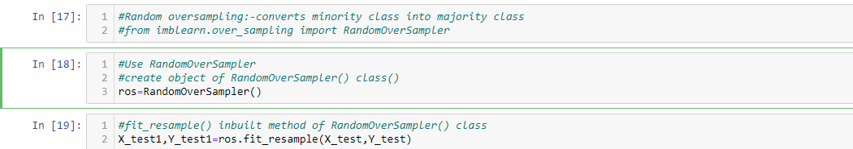
Separate The Data Before Giving To Train And Test
Have To Separate The Data Into X And Y. After Separate The Data And Then Separate The Output From The Dataset.
Perform sampling because the dataset is imbalance
Random Over Sampler :- In This We Add Duplicate Error To Balance The Data

Slide 8
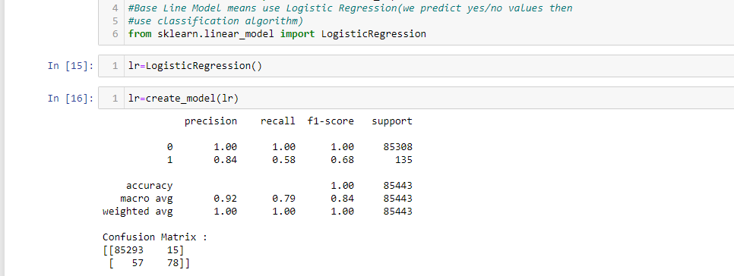
After Performing Random Over Sampler Now We Will We Give This Dataset To Different Algorithm To Train
Logistic Regression :-Is Use To Check The Accuracy Score And The Output Should Be From 0 To 1.
The Machine Perform Sigmoid Function.
Its Not Giving Good Accuracy Score So Now We Have To Give To Decision Tree

Slide 9
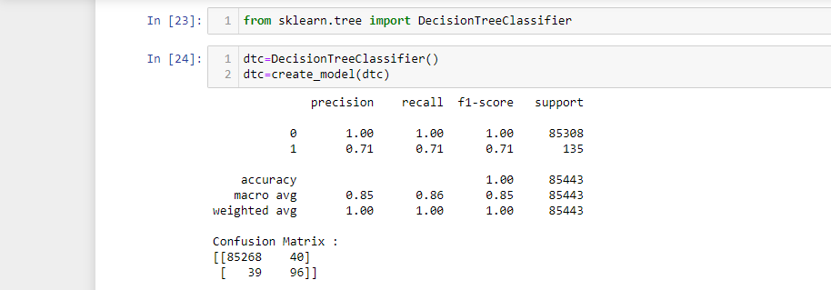
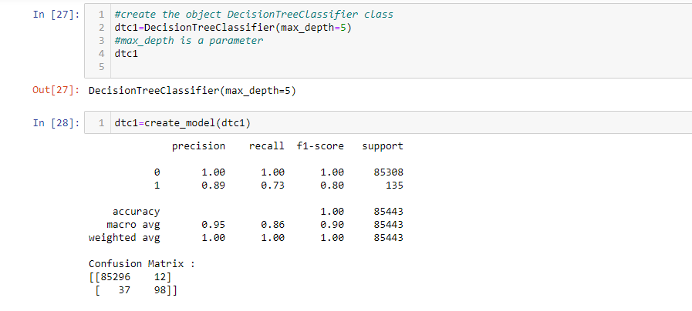
Second algorithm decision tree classifier(with gini index )
Gini Index Means Sign Impurity(error) Those Impurity Is High That Will Not Use Those Are Are Having Low Impurity We Will Use Them By Default It Will Take Gini Index.
Decision Tree With Max_depth=5 (Parameter)

Slide 10
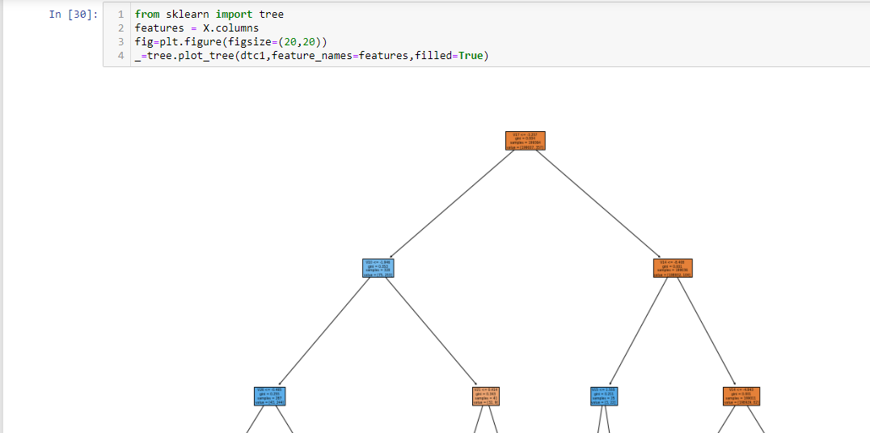
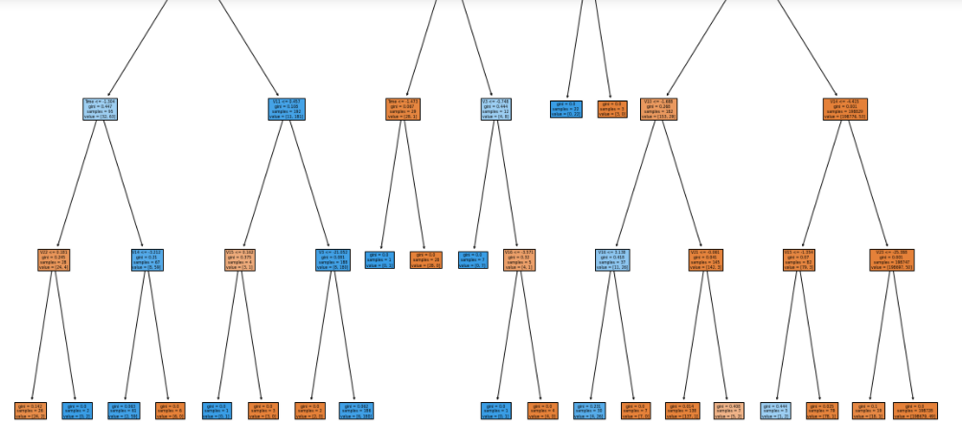
Decision tree plot with max_depth and min_samples leaf

Slide 11
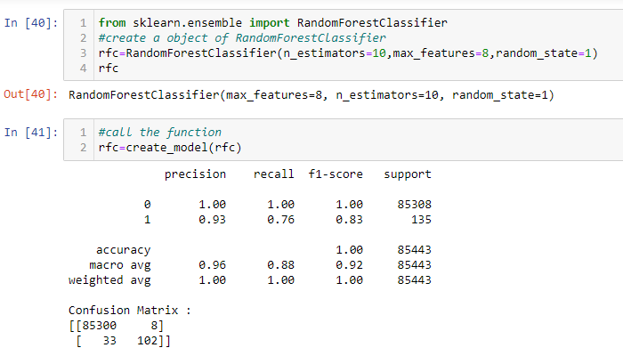
Third Algorithm Ensembling Technique
Random Forest Tree :- It Is Type Of Bagging In Which We Take Decision Tree Classifier As A Parameter.
With Random Forest Tree We Have Increase Are Recall Score But We Will Try For More With Stacking Classifier

Slide 12
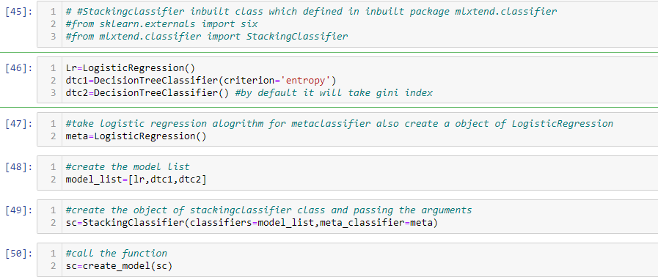
STACKING CLASSIFIER
In Stacking Classifier :-We Train Different Algorithm On Same Data. And Get Output From All Of Them And Change It Into Input In Meta Classifier And Then We Give Final Output.

Slide 13
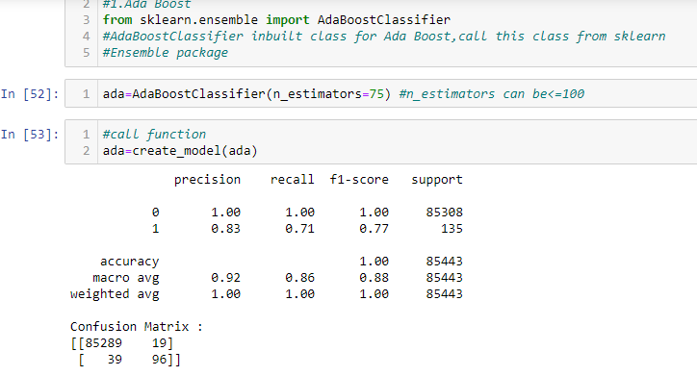
Boosting Technique It Is A Part For Ensembling Technique
Ada Boost
Graident Boost
Extreme Gradient Boost
Ada Boost :-It Create Decision Stump. It Is Also Known As Weak Learner Decision Stump Means One Root And Two Leaf.
Ada Boost Take First Input Features Which Is Most Important Then Others With The Help Of Gini Index & Entropy

Slide 14
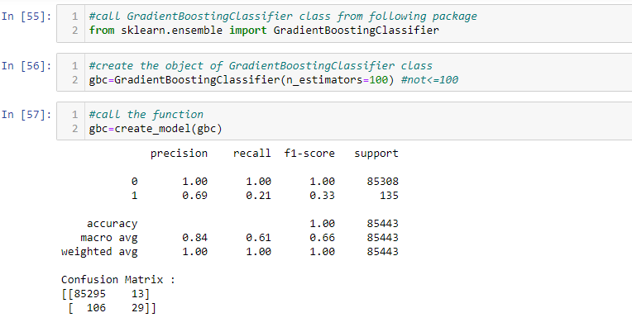
GRADINET BOOSTING
Its Bascially Focus On Short Coming Error Means Fully Grown Tree Error Means Residual = Actual Output-predicted Output
2.Gradient Boost Technique:-second Tech, Of Boosting Ensembling Technique
GB :- Its Create A Fully Grown Tree: This Algorithm Is Focus On Short Coming Means Error

Slide 15
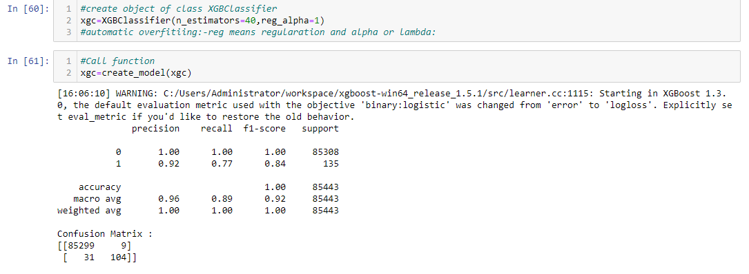
Extreme Gradient Boosting
3.Extreame Gradient Boosting : 3rd Technique Of Boosting
This Is Better Version Of Gradient Boosting . . Short Form XGB
1. XG Boosting Use : - Multithreading Technique
2. It Takes Less Memory Space And Faster
3. It Is Very Useful To Handle Huge Amt Of Data .Its Deal Large Amount Of Data
4. Its Handle Outlier Because Have Inbuilt Capability
5. Its Handle Null Values
6. Its Handle Automatic Overfitting Situation.
Install The External Package From Python's Community First For Xgboost
#!Pip Install Xgboost
From Xgboost Import Xgbclassifier

Slide 16
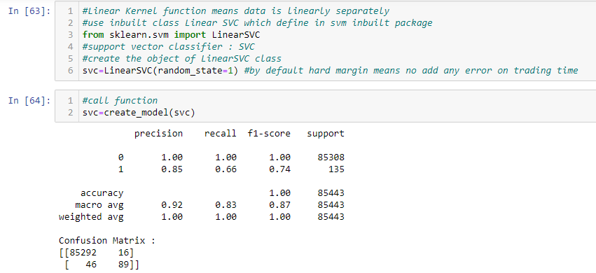
SUPPORT VECTOR MACHINE (SVM)
There Are Various Kernel Functions:
1.Linear Kernel Function (Use Linear Separated Data)
2.Polynominal Kernel Function (Non-linear)
3.Radial Basis Kernel Function (Non-linearly)’‘’
In Support Vector Machine Out Main Goal Is To Achieve Maximum Margin With Decision Boundary.

Slide 17
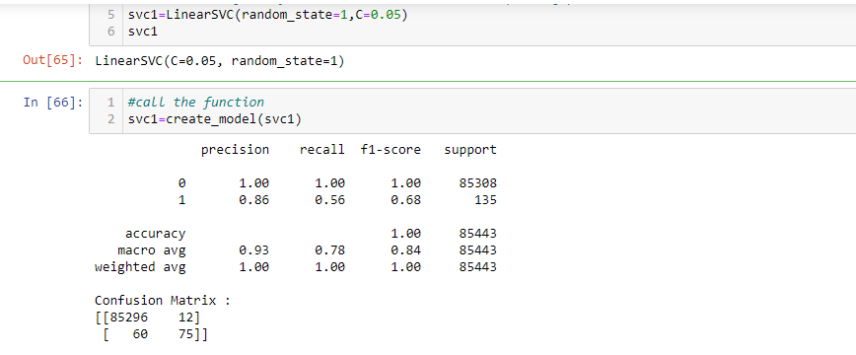
LINEAR KERNEL FUNCTION
First Linear Kernel Function :-Score Is Not Good So We Will Apply Soft Margin To Reduce Overfitting Create The Object Of Inbuilt Class Linear SVC And Passing Parameter C.
From The Above Score We Understand That Data Is Not Linear Means Its Non-linear data So Here We Have To Perform Poly nominal Kernel Function .

Slide 18
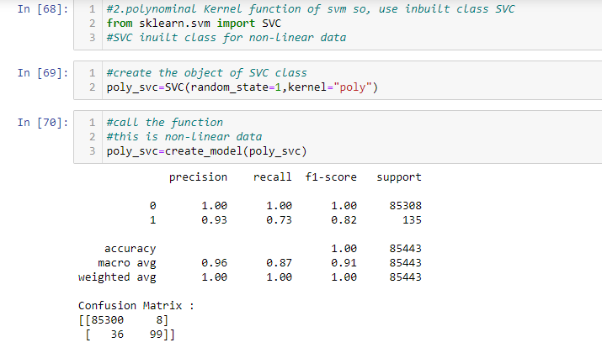
POLYNOMINAL KERNEL FUNCTION
Here If Add External Error On Runtime But No Changes In Score Means No Effect On Score
Means We Have Data Is Non-linear Data , Not Linear Dataset
So We Will Use Polynomial Kernel Function Means Increase The Dimension Means
To Converts Low Dimension Data Into High Dimension Means If Plot 1D Then Converting Into 2D Dimension And So On.

Slide 19
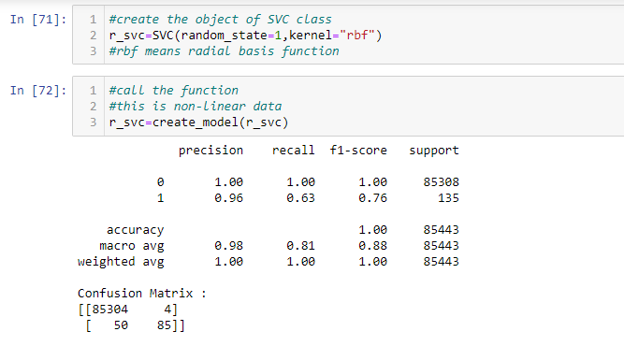
RADIAL BASIS FUNCTION
In This If The Data Is Exactly On Circle The He Will Check The Data Is Nearest To Yes/ No. If It Is Near Then He Will Perform Radial Basis Function.
If The Data Is Effected By Circle Then We Can Use Radial Basis Function
With The Help Of Radial Basis Function We Are Not Getting Good Score Means Radial Basis Fail To Accurate Good Score

Slide 20
WHICH TYPE OF ALGORITHM WE HAVE USE TO DETECT FRAUD DETECTION
Various Type Of Algorithm We Have Use In This Project To Get Good Score
The Algorithm We Perform In This Project:-
Logistic Regression
Decision Tree Classifier (Gini Index )
Decision Tree Classifier With (Entropy)
Ensembling Technique
Random Forest Tree
Stacking
Ada Boosting
Gradient Boosting
Extreme Gradient Boosting
Support Vector Machine (Svm)
Linear Kernel Function
Poly Nominal Kernel Function
Radial Basis Function

Slide 21
CONCLUSION
Fraud Detection System Have Become Essential For Banks And Financial Institution To Minimize Losses. We Designed A System To Detect Fraud In Credit Card Transaction. This System Is Capable Of Providing Most Of The Essential Features Required To Detect Fraudulent And Legitimate Transaction.
We Conclude That We Have Receive The Best Score From :-
Decision Tree Classifier(entropy)
Decision Tree Classifier(gini Index)
In Ensembling Technique From :-
Boostraping
Random Forest Tree
Ada Boosting
Extreme Gradient Boosting

